Slide 1
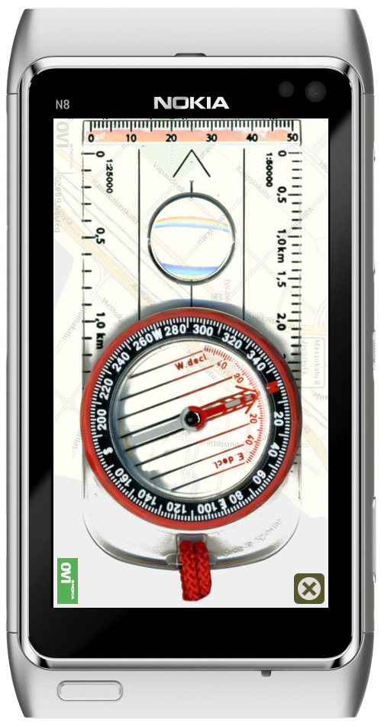
Compass – Navigation mode
Teaches the use of traditional compass
The needle points always to the north (at the start of app, the compass must be calibrated by rotating the phone in all of its axis, indicator shows when the compass is calibrated)
The 360 degree scale of the compass can be rotated
In this mode the compass can be used with a real life map (this is useful if the GPS does not work)
Can be used in both portrait and landscape modes

Slide 2
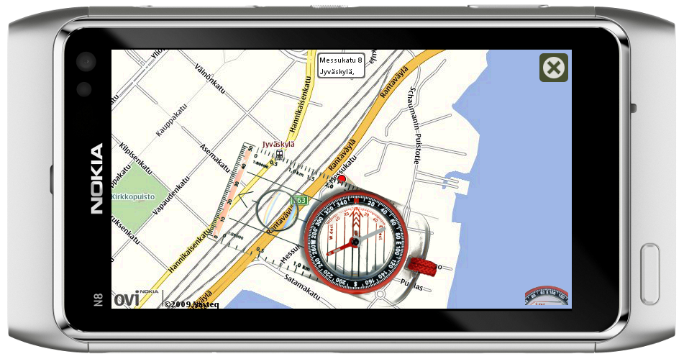
Compass – Map mode
Gets the position with GPS
Downloads the OVI map by using OVI maps rendering API
The map can be panned and zoomed with pinch
The compass can be rotated and positioned on top of the map
The 360 degree scale of the compass should be rotated to the map north
The switching between map and navigation mode is triggered with a button in bottom right corner
The map will track the waypoints while moving, the waypoints are drawn on top of the map using OVI maps rendering API

Slide 3
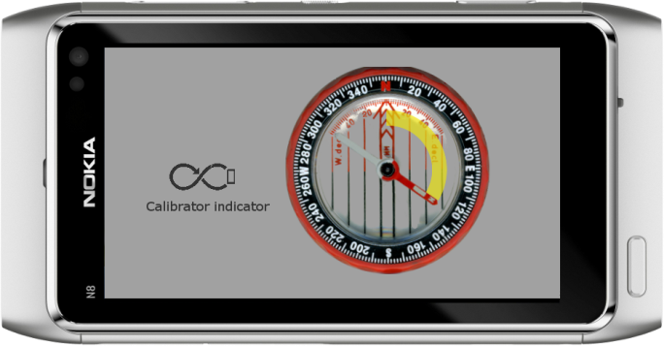
Compass – Calibration mode
If the compass requires calibration, a calibration view is shown
The scale of the compass is switched to range 0 – 100 %
The needle shows the current calibration level, the needle leaves a nice yellow trail behind it when the calibration advances
The 8-figure indicator on the left informs the user to rotate the device around all of its axis
<number> © 2010 Digia Plc

Slide 4
Compass – Technical implementation
The example demonstrates:
Use of OVI maps rendering API with Flickable and WebView elements
Later, when Qt Mobility 1.2 is available the map is retrieved with QML Map element
The compass infomation is retrieved with Qt QCompass sensor, later compass information will be resolved with the QML Compass element when Qt Mobility 1.2 is available
The GPS location is retrieved first by Qt Mobility class QGeoPositionInfoSource, and later with QML element PositionSource
The pinch feature to zoom map by using experimental QML element GestureArea

Slide 5
Compass – Compatibility and work estimate
Compatibility:
Symbian^1 and Symbian^3 devices that has digital compass and GPS, multi touch support is not mandatory
Maemo 5 is not supported as it does not have digital compass
Work estimate:
Position and walked path from GPS: 2 days
Viewing of static map: 1 day
Panning and zooming of map: 3-8 days
Packaging, SCM, project tasks, graphics: 3 days
Total: 9–14 days

